Slide 1
Data Science: Street Fighting Statistics
John Mount, Win Vector LLC

Slide 2

Introduction
I am a Principal Consultant at Win Vector LLC. I have a Ph.D in computer science from Carnegie Mellon University, using probabilistic methods to prove convergence rates of Markov chains in optimization and sampling applications.
Co-author Practical Data Science with R
Co-author of several R packages
vtreat
wrapr
cdata
WVPlots
Author of several Python data science packages
vtreat
data_algebra
wvpy
Notes:
I worked on structural diversity of molecules for biotech applications, wrote and executed algorithmic trading strategies for Banc of America securities (a division of Bank of America). I am now concentrating on data science, machine learning, AI and analytics consulting and teaching. My most recent teaching product is a two week private immersion course on data science for engineers.

Slide 3
Statistics versus Data Science
There is a tension between statistics and data science.
Statistics emphasizes model identification and inference.
Data Science emphasizes quality of model predictions.
Either field can be made to look bad by judging it in terms of the other’s concerns. Neither field can claim priority in consulting (that would be operations research!).
I will show what it looks like to rush from data to building a predictive model (supervised machine learning). Also, I will demonstrate some of the joy of working fast in idiomatic R.
Notes:
Machine learning practice, often called data science, emphasizes empirical tuning of predictive models. When these practitioners run into common problems they propose and promote fixes somewhat different than the statistical canon. I’ll discuss two issues where data science practice differs from statistical inference: co-linear variables and building classifiers for un-balanced models. For co-linear variables the data science practice is often “regularize and ignore”, which I will define and explain why this fire and forget procedure seems to work. This lets us start to explore the consequences of using prediction quality as an exclusive model quality metric. For un-balanced models I argue that the result is the opposite: ignoring the internal probabilistic structure of the problem leads to unnecessarily clumsy work-arounds.

Slide 4
Supervised Machine Learning
The task data scientists tend to be interested in is “supervised machine learning.”
You are shown a table with rows of the form (X, y): try to find a function that that f(X) ~ y.
Examples:
Predicting childrens’ heights from parents’ heights.
Predicting cancer risk.
Predicting the probability of clicking on an online advertisement.
Mapping a picture to a description (f(X) ~ y)
Mapping a description to picture (f(y) ~ X)
(tends to ignore issues of cause!)

Slide 5

Problems and Practices
Judging a process merely by the results can simplify things, but also obscure important distinctions. This is the risk of “fit to finish” processes that are judged only on their final output.
It can seem that the practice of data science is memorizing an infinite number of arcane rituals. Many of the tool suppliers would like it to be that way.
Instead of this magical thinking, organize procedures by what they purport to fix.
Gregor Sailer, The Potemkin Village

Slide 6
The Fixes by what they Purport to Fix
defensive ritual(s) | legitimate fear(s)
regularization, variable pruning, principal components analysis | over-fit, co-linear variables
out of sample evaluation, cross methods, ensemble methods, bagging, maximum entropy methods | over-fit
re-weighting data | heteroskedastic errors, concept drift, unbalanced classification classes
non-linear outcome transforms, neural nets, tree methods | heteroskedastic errors, non-linear response structure
interactions, machine learning, neural nets, tree methods, boosting, stacking | under-expressive models, don’t know structure of relation
hyper parameter search | unstable models, under-specified modeling techniques
Bayesian inference | neglecting prior knowledge and unobserved state

Slide 7
This Talk
In this talk I’ll discuss predictive modeling, and two of the earlier bugbears:
co-linear variables
unbalanced classification classes
This is a chance to review some “street fighting statistics in R.”
All slides and material here: https://github.com/WinVector/Examples/tree/main/Street_Fighting_Statistics.

Slide 8

Co-Linear Variables
Variables that imitate each other, which to use?

Slide 9
Co-Linear Variables, some data
Consider the following famous data set, Galton’s height data. Galton didn’t start with multi-variate regression, so he introduced a variable called “mid_parent”.
d <- read.table("galton-stata11.tab", header = TRUE) d$mid_parent = (d$father + 1.08 * d$mother) / 2 d |> head() |> knitr::kable()
family | father | mother | gender | height | kids | male | female | mid_parent
1 | 78.5 | 67.0 | M | 73.2 | 4 | 1 | 0 | 75.43
1 | 78.5 | 67.0 | F | 69.2 | 4 | 0 | 1 | 75.43
1 | 78.5 | 67.0 | F | 69.0 | 4 | 0 | 1 | 75.43
1 | 78.5 | 67.0 | F | 69.0 | 4 | 0 | 1 | 75.43
2 | 75.5 | 66.5 | M | 73.5 | 4 | 1 | 0 | 73.66
2 | 75.5 | 66.5 | M | 72.5 | 4 | 1 | 0 | 73.66

Slide 10
Held Out Evaluation
In deployment or production most data we see was not available when the model was trained! We try to simulate this for our evaluation by using held-out data.
# build a per-family test/train split families <- unique(d$family) train_families <- sample( families, size = 0.8 * length(families), replace = FALSE) d_train <- d[d$family %in% train_families, ] d_test <- d[!(d$family %in% train_families), ]

Slide 11
A Model
Here is a standard model. Notice mid_parent is suppressed as it is co-linear with some combination of father and mother.
model_1 <- lm( # standard OLS model height ~ father + mother + mid_parent, data = d_train) summary(model_1)$coefficients |> knitr::kable()
 | Estimate | Std. Error | t value | Pr(>|t|)
(Intercept) | 17.6988709 | 4.7386736 | 3.734984 | 0.0002028
father | 0.3954401 | 0.0531564 | 7.439183 | 0.0000000
mother | 0.3387789 | 0.0568957 | 5.954380 | 0.0000000

Slide 12

Picking one variable over another

Slide 13
Another Model
var_cols <- c("father", "mother", "mid_parent") model_2 <- glmnet::glmnet( # L2 regularized model x = as.matrix(d_train[ , var_cols]), y = d_train[["height"]], alpha = 0, lambda = 1e-3) model_2$beta |> as.matrix() |> knitr::kable()
 | s0
father | 0.4187379
mother | 0.3639861
mid_parent | -0.0466252

Slide 14
How effectively different are the models?
Indistinguishable.
preds_1 <- predict(model_1, newdata = d_test) sqrt(mean((d_test[["height"]] - preds_1)^2))
[1] 3.435245
preds_2 <- as.numeric( predict(model_2, as.matrix( d_test[ , var_cols]))) sqrt(mean((d_test[["height"]] - preds_2)^2))
[1] 3.435255
sqrt(mean((preds_1 - preds_2)^2))
[1] 9.080205e-05

Slide 15
How semantically different are the models?
Very Different.
The traditional model has made the decision to suppress mid_parent.
This means the model is immune to any harm this variable could inflict in the future. Say for example some day in the future it is calculated or stored wrong in our data source.
Actually a super important decision, perhaps best left to the practitioner to decide which of father, mother, or mid_parent should be dropped.
The L2 regularized (or Ridge Regression or Tikhonov Regularized) model keeps all variables, but tries to enforce small (near zero) coefficients.
This is a “fire and forget strategy.”
Works well if the average of the variables is more stable than the individual variables, as it often is.

Slide 16
The Fit to Finish Dilemma
Machine learning or AI-training builds a model that is superficially indistinguishable from a correct model.
Often best possible on training data. In the absence of over-fit issues may be nearly best possible on hold out data.
The statistics view
May still be the wrong model, with wrong coefficients inferred.
Model identification is important, as the model may be called on an example not similar to the training data.
The data science view
“I am paid to call predict(), we are done here.” (For many business situations, this is in fact the right answer!)
Model identification can be pointless when don’t have the right model structure, and without that we can’t expect reliable predictions for distributionally different examples.

Slide 17
Some Commentary
The claimed above statistical view hopes to estimate the correct conditional distribution P[y | X] for all X.
The claimed above data science view hopes to estimate the correct joint distribution P[X, y] for only (X, y) exchangeable with the training data.
Not the same problem (despite Bayes’ Law)! Either can be warped into a criticism.

Slide 18

Unbalanced Classification Classes

Slide 19
Tools deforming the hands
Data scientist over-worry about unbalanced classes in classification problems.
This distinction is a bit stronger in the Python data science community as the Python sklearn .predict() interface returns class labels instead of links or probabilities.
The R predict() interface doesn’t have this issue.
R users are more comfortable with statistical concepts such as uncertainty, probabilities, odds-ratios, and log-odds-ratios.
Some modeling tooling exists to support fixes that repair problems introduced by other fixes (complexity death spiral).

Slide 20
A Classification Example
For our classification example, let’s take a BCSC breast cancer data set.
For this model breast_cancer_history codes to 0 (no cancer), or 1 (cancer) for all instances with known cancer status. Each row is weighted by how many examples like the given row are in a larger ideal data set.
d_orig <- read.csv( "bcsc_risk_factors_summarized1_092020.csv.gz") d <- d_orig[d_orig$breast_cancer_history %in% c(0, 1), ] sum(d["breast_cancer_history"] * d["count"]) / sum(d["count"])
[1] 0.1034583
The prevalence of cancer, among those instances with known cancer determination, is about 10.3%.

Slide 21
Preparing the data
All the variables in this model are re-coded categoricals, so we need to force them to be treated as strings.
vars <- c( "year", "age_group_5_years", "race_eth", "first_degree_hx", "age_menarche", "age_first_birth", "BIRADS_breast_density", "current_hrt", "menopaus", "bmi_group", "biophx") for(v in vars) { d[v] <- as.character(d[[v]]) }

Slide 22
Building a classification model
We can fit a logistic regression classification model on this data.
model <- glm( wrapr::mk_formula( "breast_cancer_history", vars, extra_values = list(d = d) # to find weights! ), data = d, family = binomial(link = "logit"), weights = d[["count"]])

Slide 23
Using the model
Let’s see what sort of cancer risk the model associates with each of our example situations.
predict(model, newdata = d, type="response")[1: 3]
1 2 3 0.006407362 0.109373072 0.006369305
Remember each outcome we are trying to match is 0 or 1 (and each row in the data set can represent multiple individuals).
library(data.table) data.table(d)[, .(count = sum(count)), by = breast_cancer_history] |> knitr::kable()
breast_cancer_history | count
0 | 1497378
1 | 172793

Slide 24
Probabilities
By default predict.glm returns probabilities or frequencies. We can see these match actual incidence on training data.
sum(predict(model, newdata = d, type="response") * d["count"]) / sum(d["count"])
[1] 0.1034583
sum(d["breast_cancer_history"] * d["count"]) / sum(d["count"])
[1] 0.1034583

Slide 25
The Fallacy
In Python .predict() returns the class label, which is defined as “1” if the probability is at least 0.5 and “0” otherwise. There is absolutely no reason for the prevalence of this label to match the data set.
sum( (predict(model, newdata = d, type="response") >= 0.5) * d["count"] ) / sum(d["count"])
[1] 0.03301997
For very imbalanced outcomes, this prevalence may in fact be zero.
Notes:
As a rule of thumb, using the prevalence as the threshold (instead of 0.5), generally returns a predicted prevalence close to the actual, and can make more useful predictions on individuals.
Alternately, you can search for the threshold that matches the prevalence.
Python does have “.predict_proba()”

Slide 26
The pointless fix
Because of the above problem many practitioners re-weight their training data to have the same number of positive and negative cases.
This fix is unnecessary.
However, it is a popular fix and writing articles how to perform this fix is a popular activity.
The imagined need for the fix likely comes from thinking the useful output of a classifier is the class-label, when in fact the estimated probability is far more useful.
Always insist on probabilities from classifiers, not “most likely class label.”
One can always convert probabilities to labels later, but you can’t do the reverse.
More on the evils of binning when you don’t have a reason: https://discourse.datamethods.org/t/categorizing-continuous-variables/3402 (though I have used the technique as “poor man’s GAM”).

Slide 27
The Underlying Problem
The view that classifiers should return categories is pernicious nonsense.
In English “accuracy” is a synonym for “quality.”
Accuracy is the most commonly asked for goodness metric for classifiers.
Accuracy is almost never the right metric when outcome classes are imbalanced
Learn to use ROC/AUC as it tells you how often your classifier’s probability orders the outcomes correctly.

Slide 28
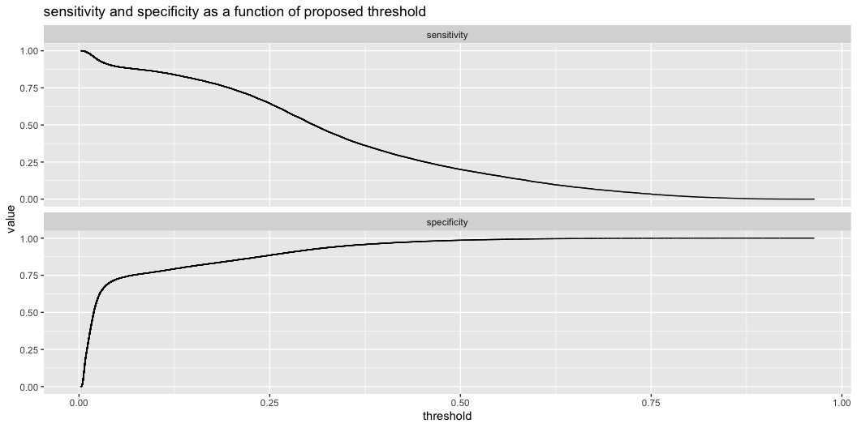
ROC plot
Don’t bother learning the ROC plot until you are comfortable with sensitivity and specificity. All the information in the ROC plot is also in this easy to read plot.
d["prediction"] <- predict(model, newdata = d, type="response") d_expanded <- d[rep(row.names(d), d[["count"]]), ] WVPlots::ThresholdPlot( d_expanded, xvar = "prediction", truthVar = "breast_cancer_history", truth_target = 1, title = "sensitivity and specificity as a function of proposed threshold")

Slide 29

Time to Wrap Up

Slide 30
Summary
Be wary of applying too many or too few tricks in your statistical or data science practice.
You may need some
You should justify each one you use
Statistics is the formal study of when samples correctly represent the population they are drawn from.
Data Science is the optimistic application of machine learning methods at scale.
Or: statisticians like to call summary() and anova(), data scientists are content to call predict().
In either case, the fears of the practitioner don’t always match the fears of the theorist, and vice versa.

Slide 31
Some of our articles on these topics
Consider reading one, not all!!!
Nina Zumel: “I don’t think that means what you think it means;” Statistics to English Translation, Part 1: Accuracy Measures.
Nina Zumel: Squeezing the Most Utility from Your Models.
Nina Zumel: Does Balancing Classes Improve Classifier Performance?
Nina Zumel: Link Functions versus Data Transforms.
Nina Zumel: The Simpler Derivation of Logistic Regression.
vtreat for R, vtreat for Python (our own super trick for re-coding high cardinality categorical variables!)
John Mount: Can a classifier that never says “yes” be useful?
John Mount: When Cross-Validation is More Powerful than Regularization.

Slide 32
Thank You!

